Slide 1
Additional Practices
Table Descriptions and Data

Slide 2

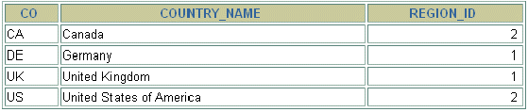
COUNTRIES Table
  DESCRIBE countries
  SELECT * FROM countries;

Slide 3
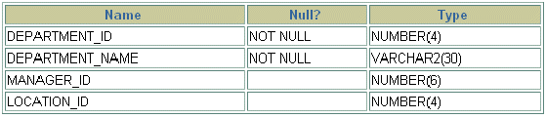
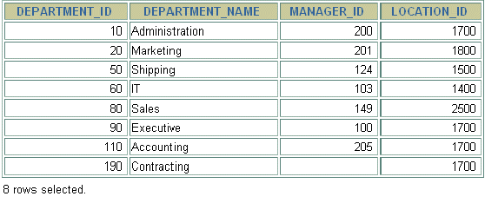
DEPARTMENTS Table
  DESCRIBE departments
  SELECT * FROM departments;

Slide 4
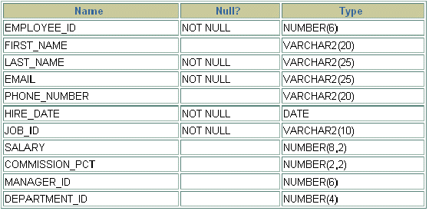
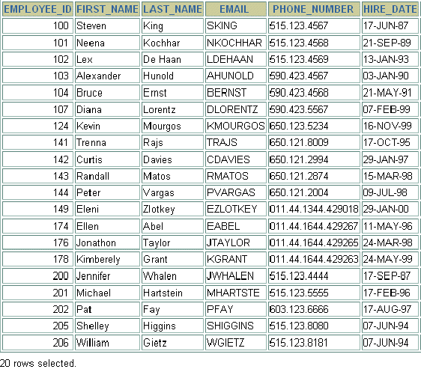
EMPLOYEES Table
  DESCRIBE employees
  SELECT * FROM employees;

Slide 5
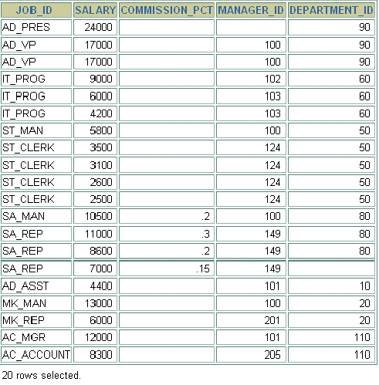
EMPLOYEES Table (continued)

Slide 6
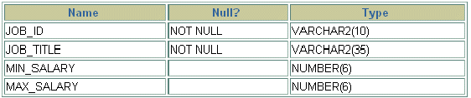
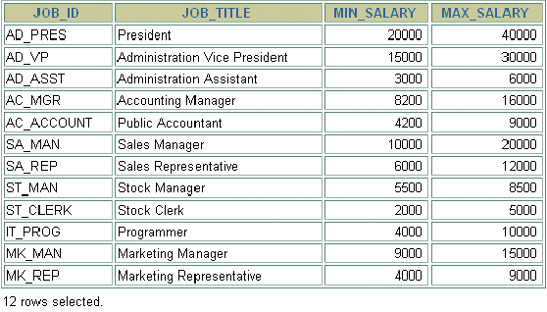
JOBS Table
  DESCRIBE jobs
  SELECT * FROM jobs;

Slide 7

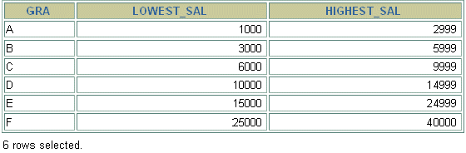
JOB_GRADES Table
  DESCRIBE job_grades
  SELECT * FROM job_grades;

Slide 8
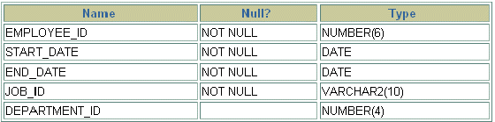
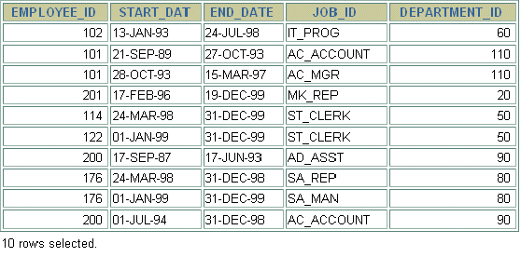
JOB_HISTORY Table
  DESCRIBE job_history
  SELECT * FROM job_history;

Slide 9
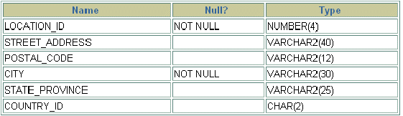
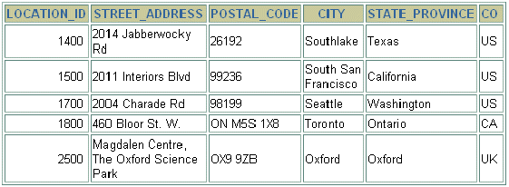
LOCATIONS Table
  DESCRIBE locations
  SELECT * FROM locations;

Slide 10

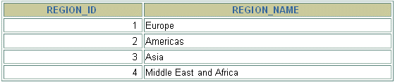
REGIONS Table
  DESCRIBE regions
  SELECT * FROM regions;

